Slide 1
Agriculture and biodiversity
Week 2
Sustainable Land Management

Slide 2
Why is agriculture important?
Notes:
Here in the UK we tend to think of species such as badgers. Foxes, hedgehogs. Also provides valuable habitat for a range of farmland bird species, wild flowering plants and trees and not to be forgotten, soil fauna and insects.

Slide 3
The global extent of agriculture
11% of the earth’s land is currently used for agriculture 13.4 billion ha (FAO, 2020)
But this represents half of the earth’s habitable and productive land.
Levels differ dramatically between countries – 70% of UK land is farmed.

Slide 4
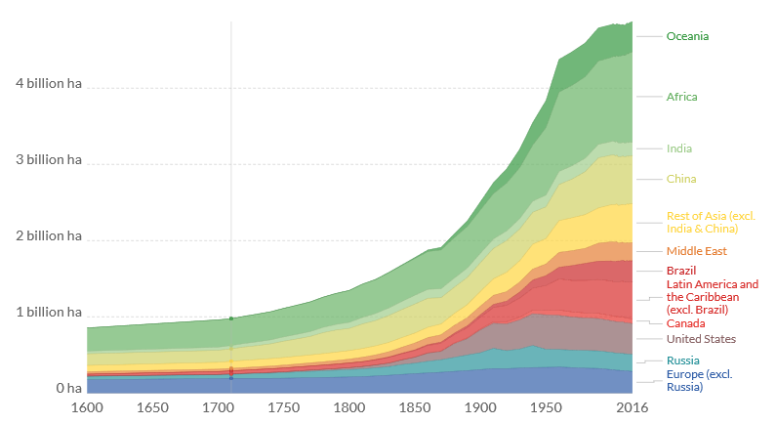
The global extent of agriculture
Rapid expansion since the 1900s
Primary cause of habitat loss
Notes:
http://themasites.pbl.nl/tridion/en/themasites/hyde/

Slide 5
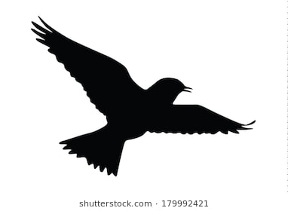
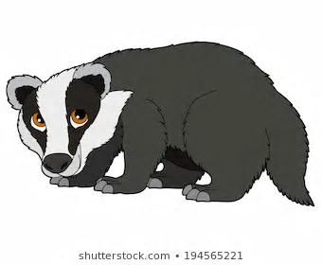
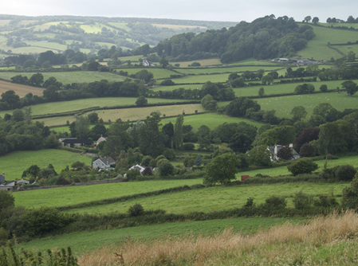
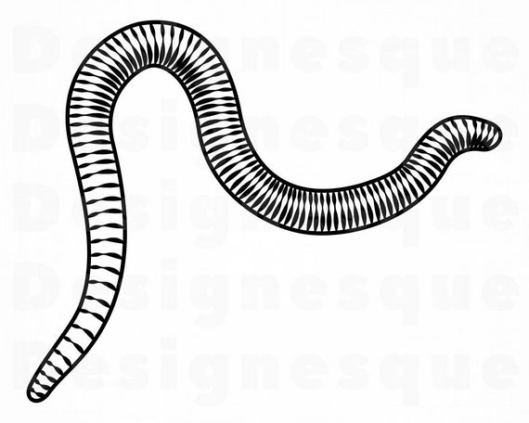
Which species are associated with agricultural systems?
Notes:
Here in the UK we tend to think of species such as badgers. Foxes, hedgehogs. Also provides valuable habitat for a range of farmland bird species, wild flowering plants and trees and not to be forgotten, soil fauna and insects.

Slide 6

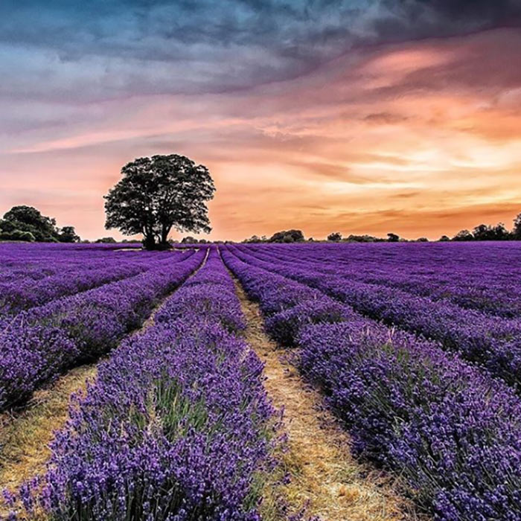

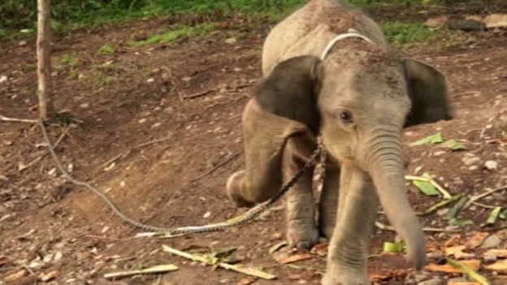

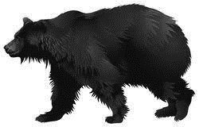

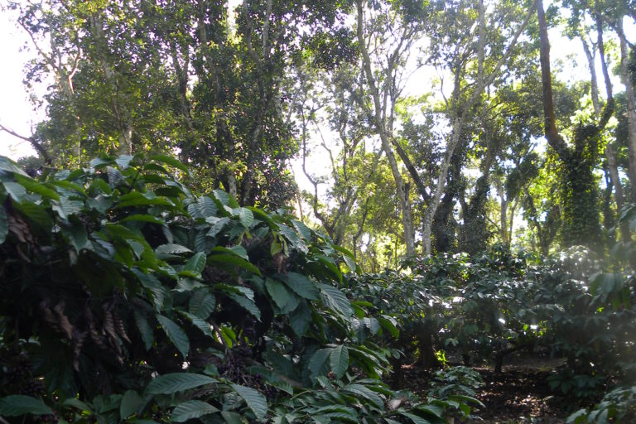

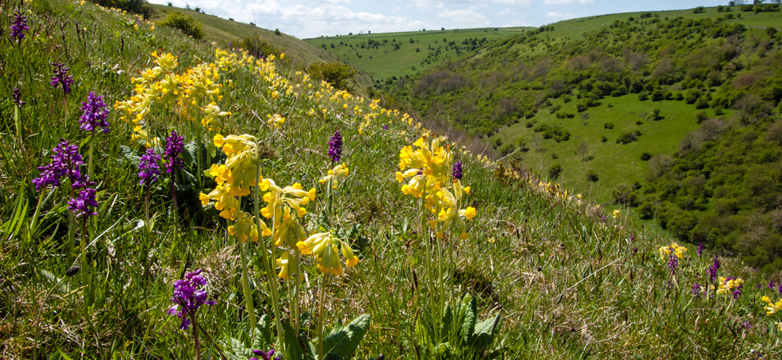

Notes:
Our food comesfrom across the globe from an extremely varied number of agricultural systems, each supporting distinct andunique wildlife. Includes rare endemic flowering plants through to large charismatic species such as elephants in Bornean Palm oil plantation above.

Slide 7
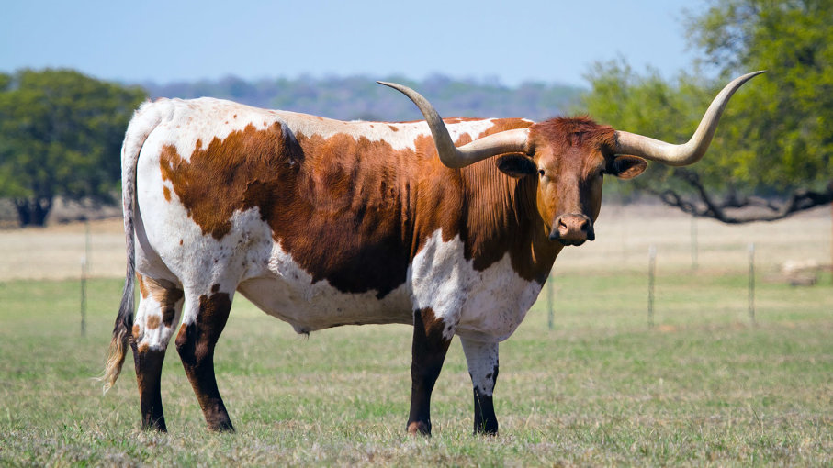
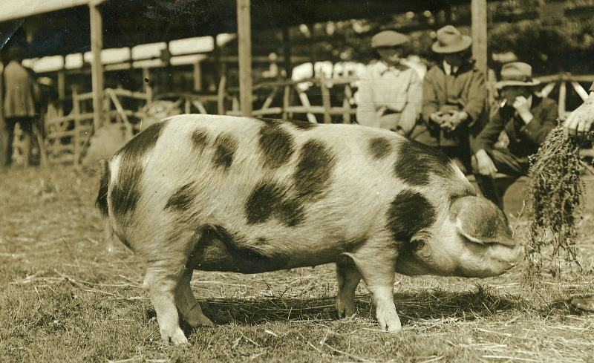
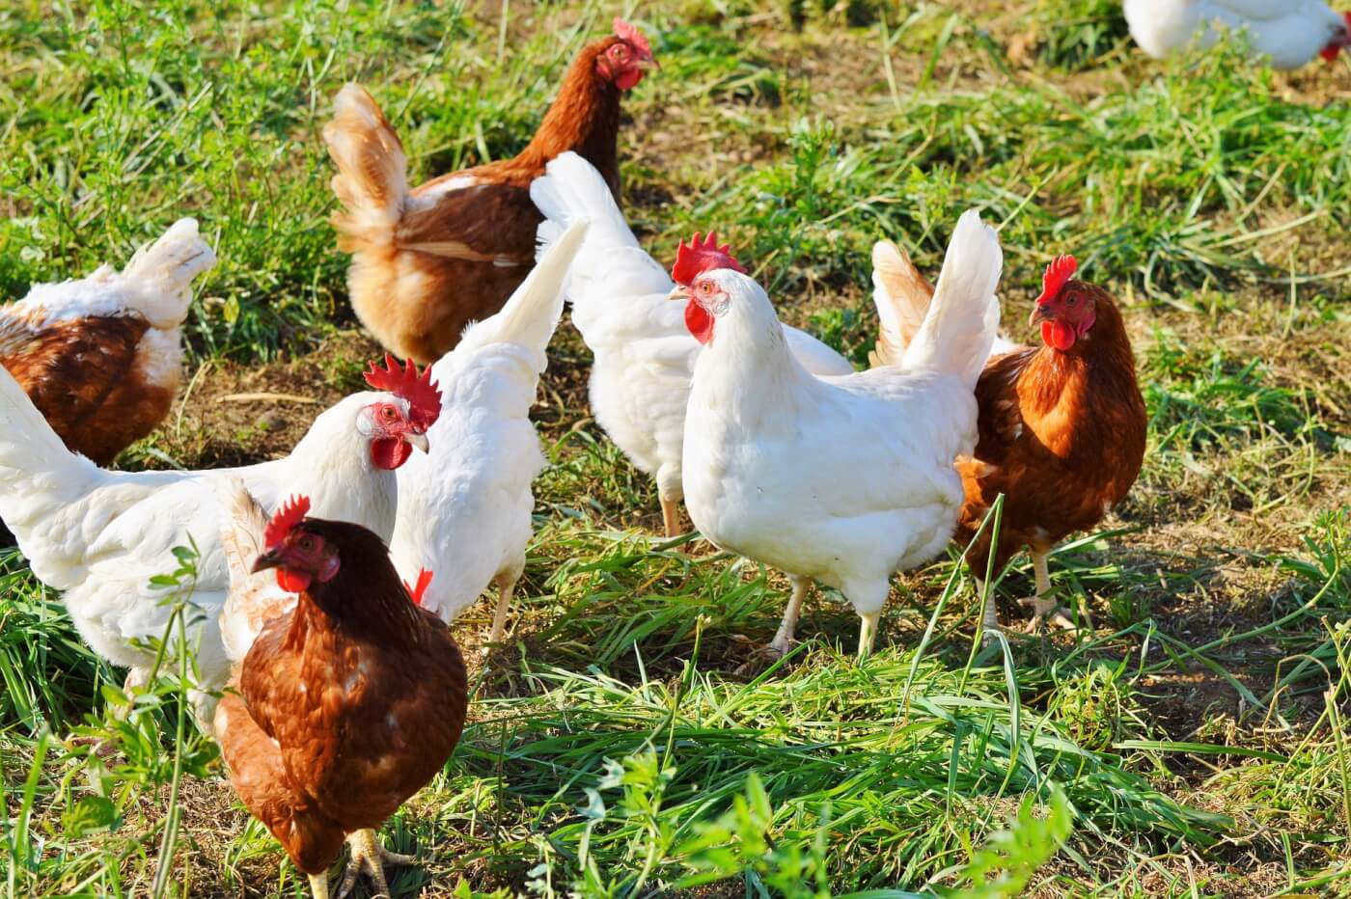
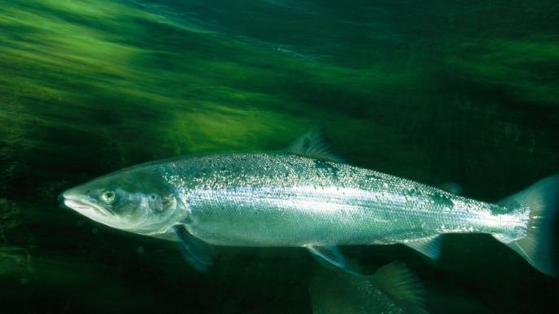
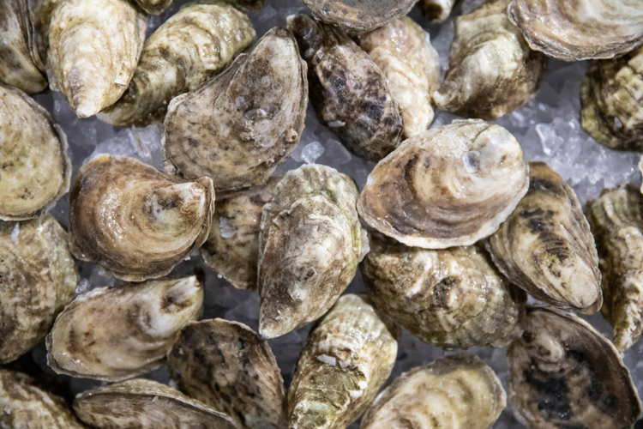
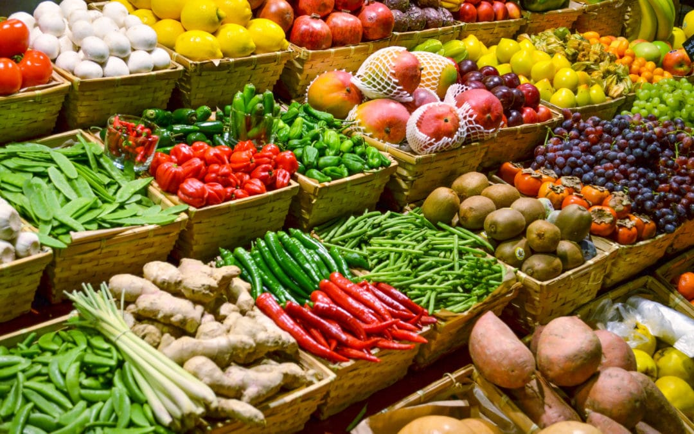
Not forgetting the diversity of the farmed animal and plant species
Notes:
Humans farm species from a wide range of taxa, from plantsherbs, trestresstrees, gastropods, snails, oysters, fish (cod farmsfarms) through topultry and sheep and cattle. All contain genetic diversity that must be conserved, old breeds etc.

Slide 8
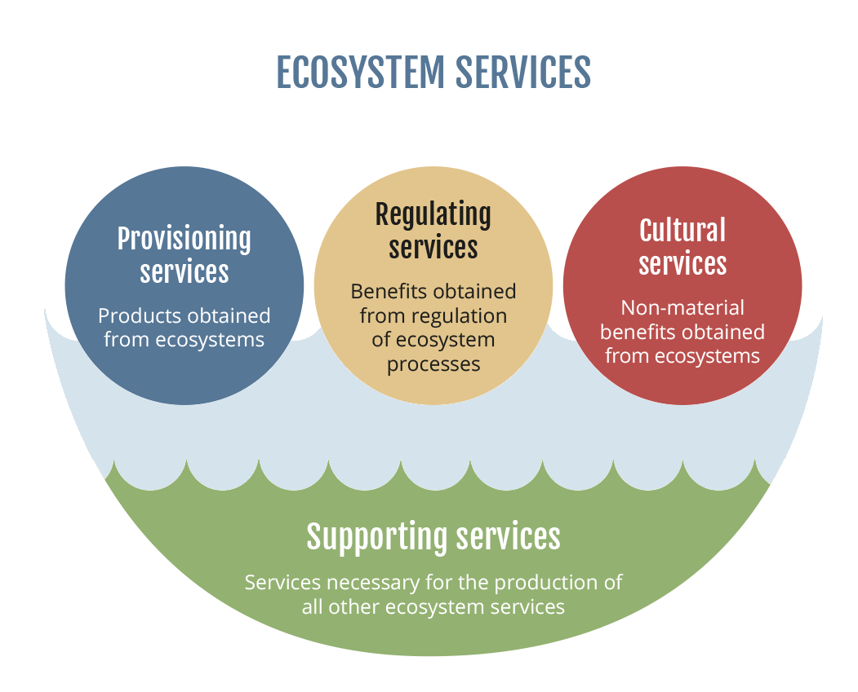
Why is biodiversity important for farming?
Notes:
Here in the UK we tend to think of species such as badgers. Foxes, hedgehogs. Also provides valuable habitat for a range of farmland bird species, wild flowering plants and trees and not to be forgotten, soil fauna and insects.

Slide 9
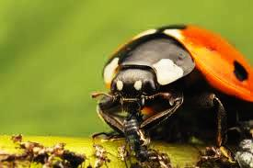
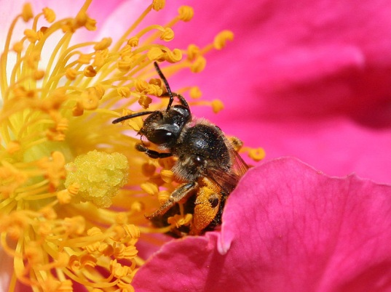
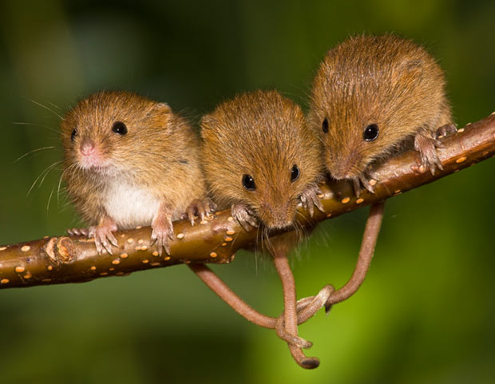
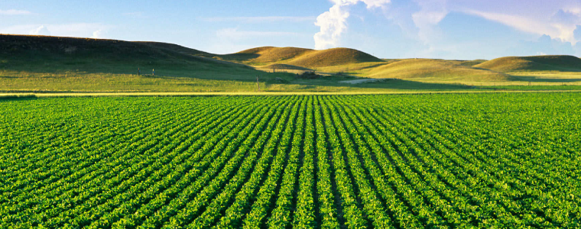
Ecosystem services to agriculture
Climate and water regulation
Soil regulation
Soil fauna needed to break down dead matter and fertilise soil
Pollination
Wild insects needed to maximise crop yields
Pest control
Natural enemies (spiders, beetles, birds) can reduce pest outbreaks

Slide 10
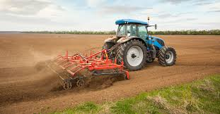
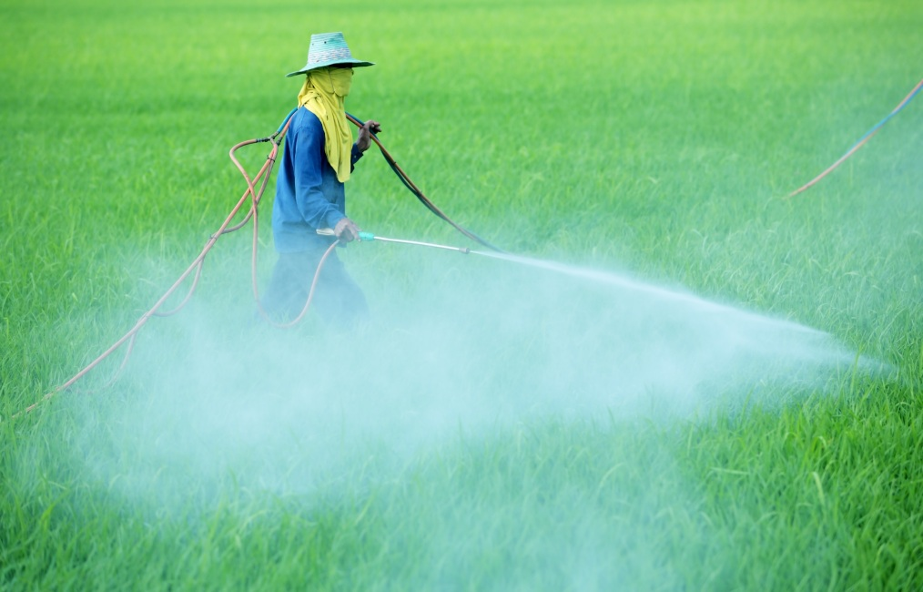
Agricultural intensification
Monocultures
Loss of diversity leads to a loss of ecosystem processes.
Regulating services no longer provided naturally.
=> requires use of fertilisers, herbicides and pesticides.
Depletes biodiversity and ecosystem service provision further

Slide 11
Biodiversity in organic versus conventional farming systems
Soil fauna
Higher in Organic
Birds
All
Predatory insects
*
*
*
*
Pests
Higher in Conventional
Bengtsson et al 2005. The effects of organic agriculture on biodiversity and abundance: a meta‐analysis.
Journal of Applied Ecology
Notes:
Meta analysis of over 70 studies – biodiversity higher on organic versus conventional farms

Slide 12
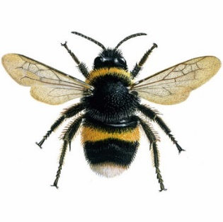


Can we put an economic value on these services?
Pollination services
Pollination estimated to contribute €153 billion to global agriculture! Gallai et al 2005
Insects contribute towards pollination of 46 global crop species
Including many that we love such as fruits, coffee and chocolate
Notes:
video

Slide 13
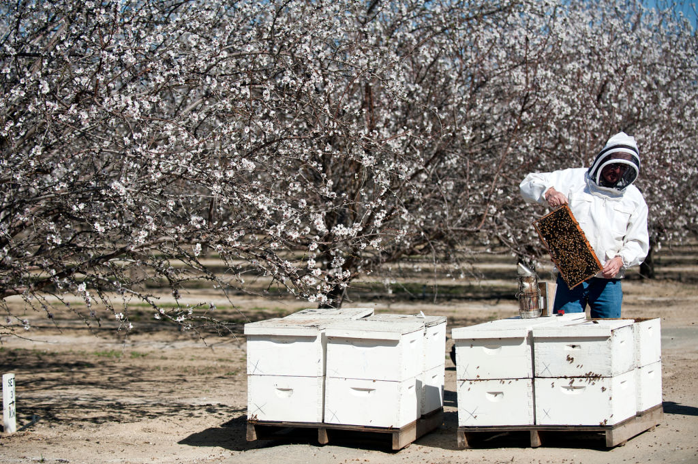
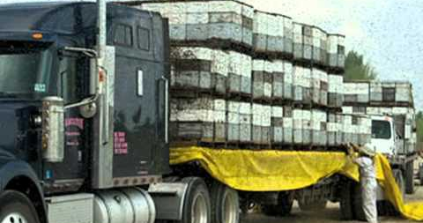
Honeybee lorries in California

Slide 14
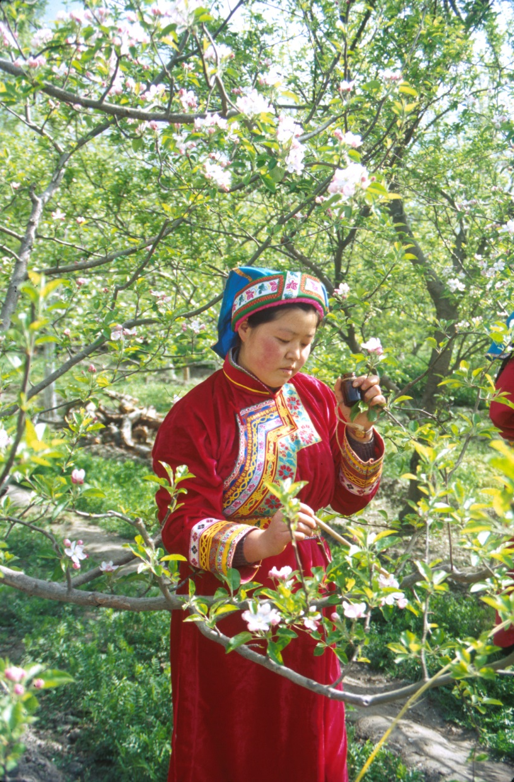
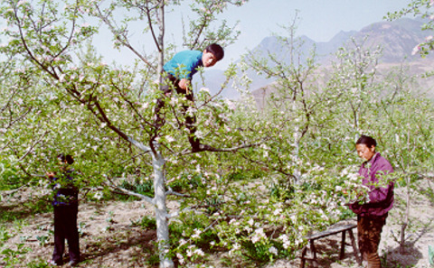
Hand-pollinated pear orchards in China

Slide 15
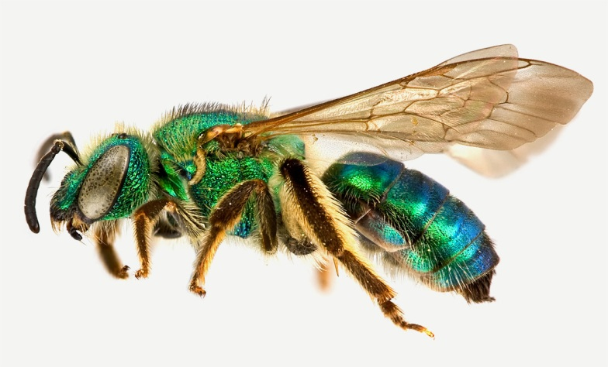
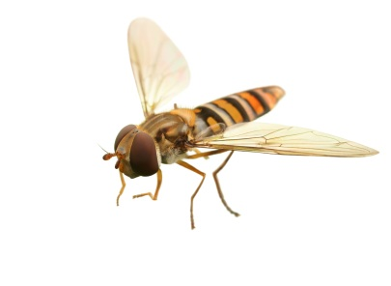
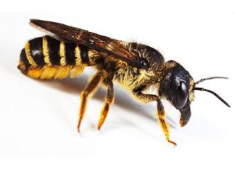
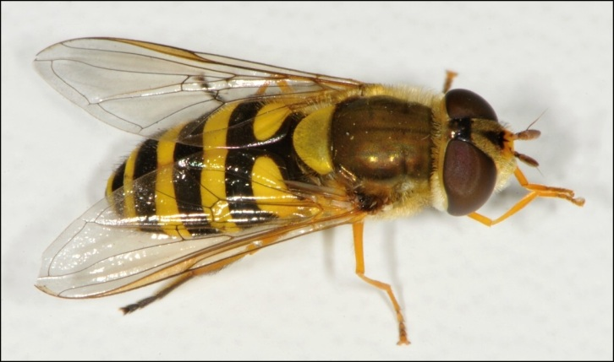
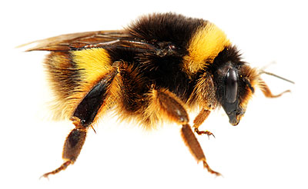
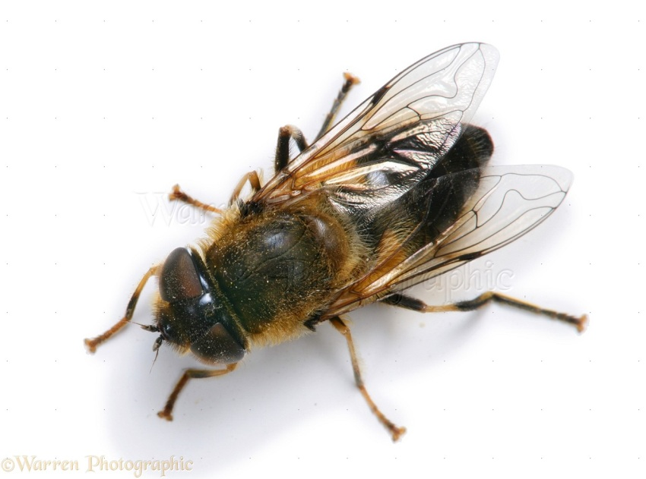
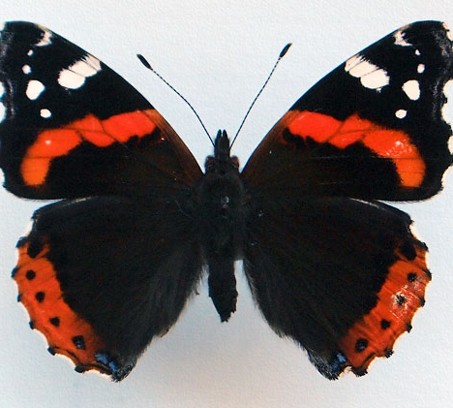
Diversity is important….

Slide 16
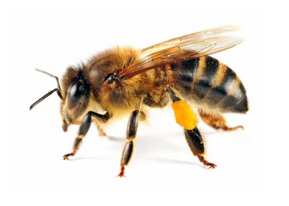
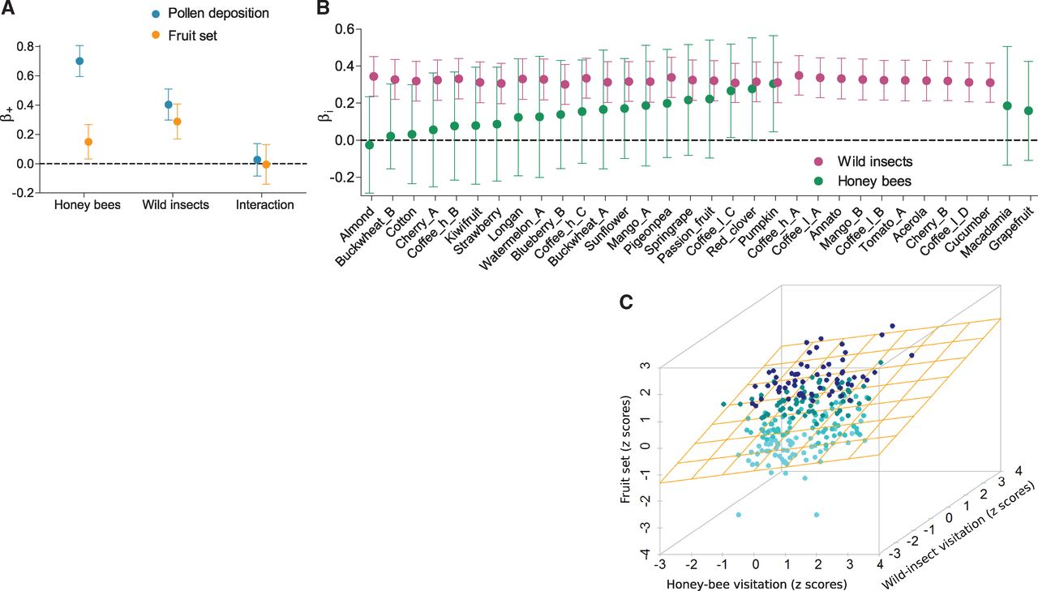
Wild Pollinators Enhance Fruit Set of Crops more than Honeybees
Effect of visitation on fruit set
Garibaldi et al (2013) Nature

Slide 17
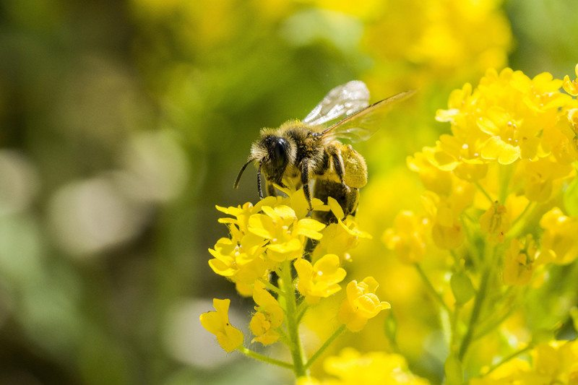
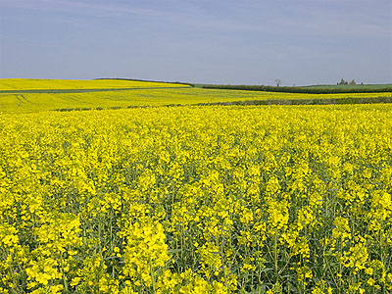
Agricultural intensification leads to pollinator declines
Monoculture means limited floral resources
Lack of diversity, seasonal shortages, nutritional gaps
Loss of nesting sites
Solitary bees are often ground-nesting, requiring specific soil conditions
Pesticides
Neonictinoids can impair learning and lead to reduced reproductive success in honeybees and bumblebees

Slide 18
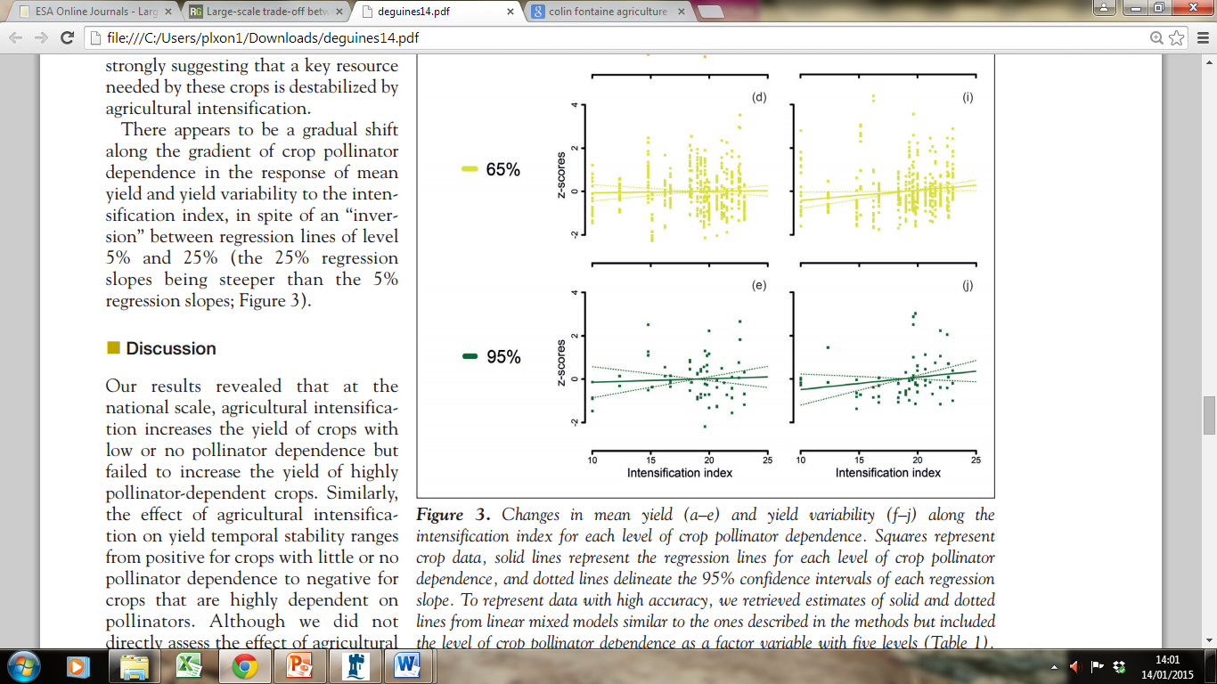
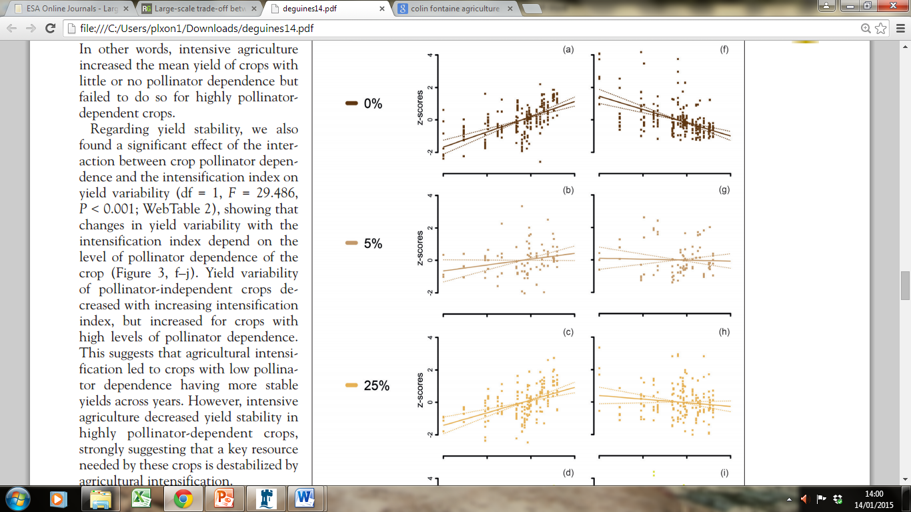
Does intensification increase yields?
Pollination
dependence (%)
Wind pollinated
eg. wheat
Fully insect pollinated
eg. apples
Not in crops that require pollination….
(Deguines et al, 2014)

Slide 19
How can we reconcile the need for increased food production with biodiversity conservation?

Slide 20
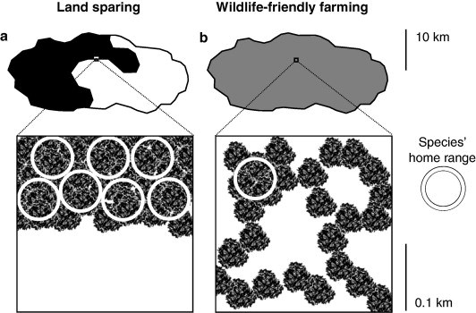
Landsparing versus landsharing?
1) Land-sparing
high yield farming combined with complete protection of “spared” natural habitat
2) Land-sharing
Nature friendly farming
Lower yields but lower biodiversity cost

Slide 21
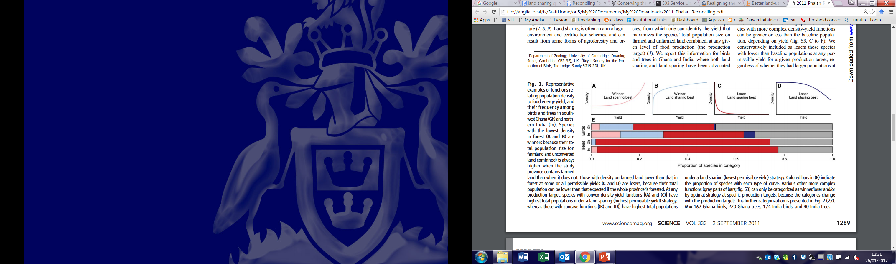
Winners and Losers
Winners: Species that increase in density in agricultural land
Phalan et al. 2011. Reconciling food production and biodiversity conservation: land sharing and land sparing compared. Science

Slide 22
Winners and Losers
Losers: Species that decrease in density in agricultural land
Phalan et al. 2011. Reconciling food production and biodiversity conservation: land sharing and land sparing compared. Science

Slide 23
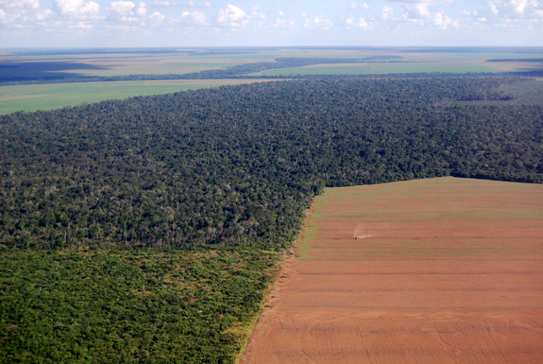


Phalan et al (2011) conclude that solution is to “substantially increase yields while simultaneously sparing and restoring natural habitat”
But the debate continues….
Sparing vs. Sharing
What are the arguments in favour of land-sharing?
Notes:
Ghana and India

Slide 24
Do we need more food?
Food is not distributed evenly
Global food production is currently sufficient, but not available to the hungry (>2 billion malnourished)
Food usage is extremely inefficient
One third is wasted and one third fed to livestock
Perhaps focus should be on waste reduction and altering diets?
Tscharntke et al (2012)
Notes:
The fundamental argument behind land-sparing is that we need more food.
In developing countries 40% lossed at post-harvest and processing level
Industrialized countries 40% at retail and consumer level

Slide 25
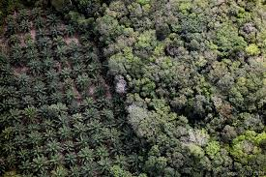
Does intensification lead to land sparing?
Rudel et al. (2009) analysed FAO data from 161 countries over 25-year period for 10 commodities:
Countries achieving yield gains tend to expand their agricultural footprints.
Ensuring land-sparing following agricultural intensification will require policy change.

Slide 26
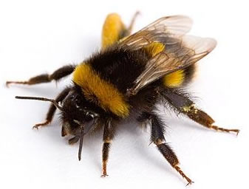
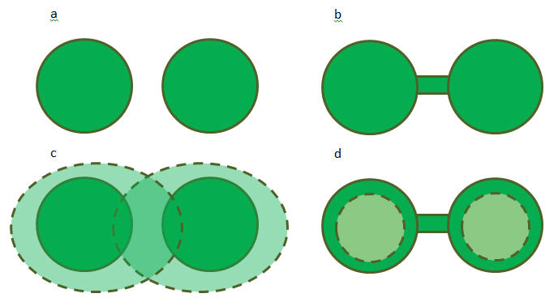
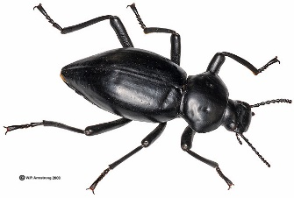
Ecosystem services in the wider landscape
Agricultural intensification degrades biodiversity and ecosystems services
Land-sharing may not maximize species conservation, but it can maintain ecosystem services across wider landscape (connectivity)
In order to maintain ecosystem services we need to conserve biodiversity on multiple spatial scales

Slide 27
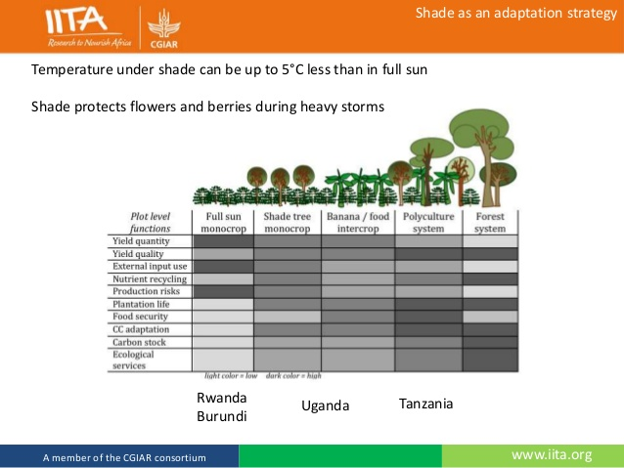
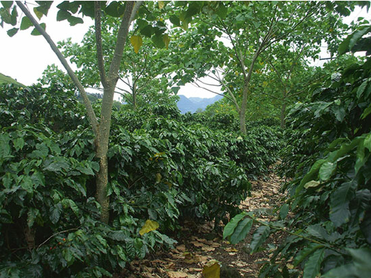
Is there a way to boost yields whilst maintaining ecosystem services?
World Agroforestry Centre (ICRAF)
Agroforestry and diverse cropping systems

Slide 28



Inter-cropping - pollination
Single crop
Intercropped 1 and 2
Inclusion of flowering basil increase fruit size in bell pepper
Pereira et al. 2015. The management of bee communities by intercropping with flowering basil enhances pollination and yield of bell pepper . Journal of Insect Conservation
Notes:
Abundance and richness of bees much higher in intercropped system.
Led to enhanced fruit size in bell pepper

Slide 29


Fertiliser trees
Inter-cropping – legumes
Legume root nodules fix atmospheric nitrogen
Enhance soil fertility, boosting crop yields
Amossé et al 2014. Contribution of relay intercropping with legume cover crops on nitrogen dynamics in organic grain systems. Nutrient cycling in agroecosystems,

Slide 30


The future? Agro-ecological intensification
Reconciles land sparing/sharing debate by intensifying yields sustainably
Increasing productivity by promoting and regenerating favorable biological interactions
Using farming methods that rely on knowledge and labor, as opposed to external inputs

